Slide 1
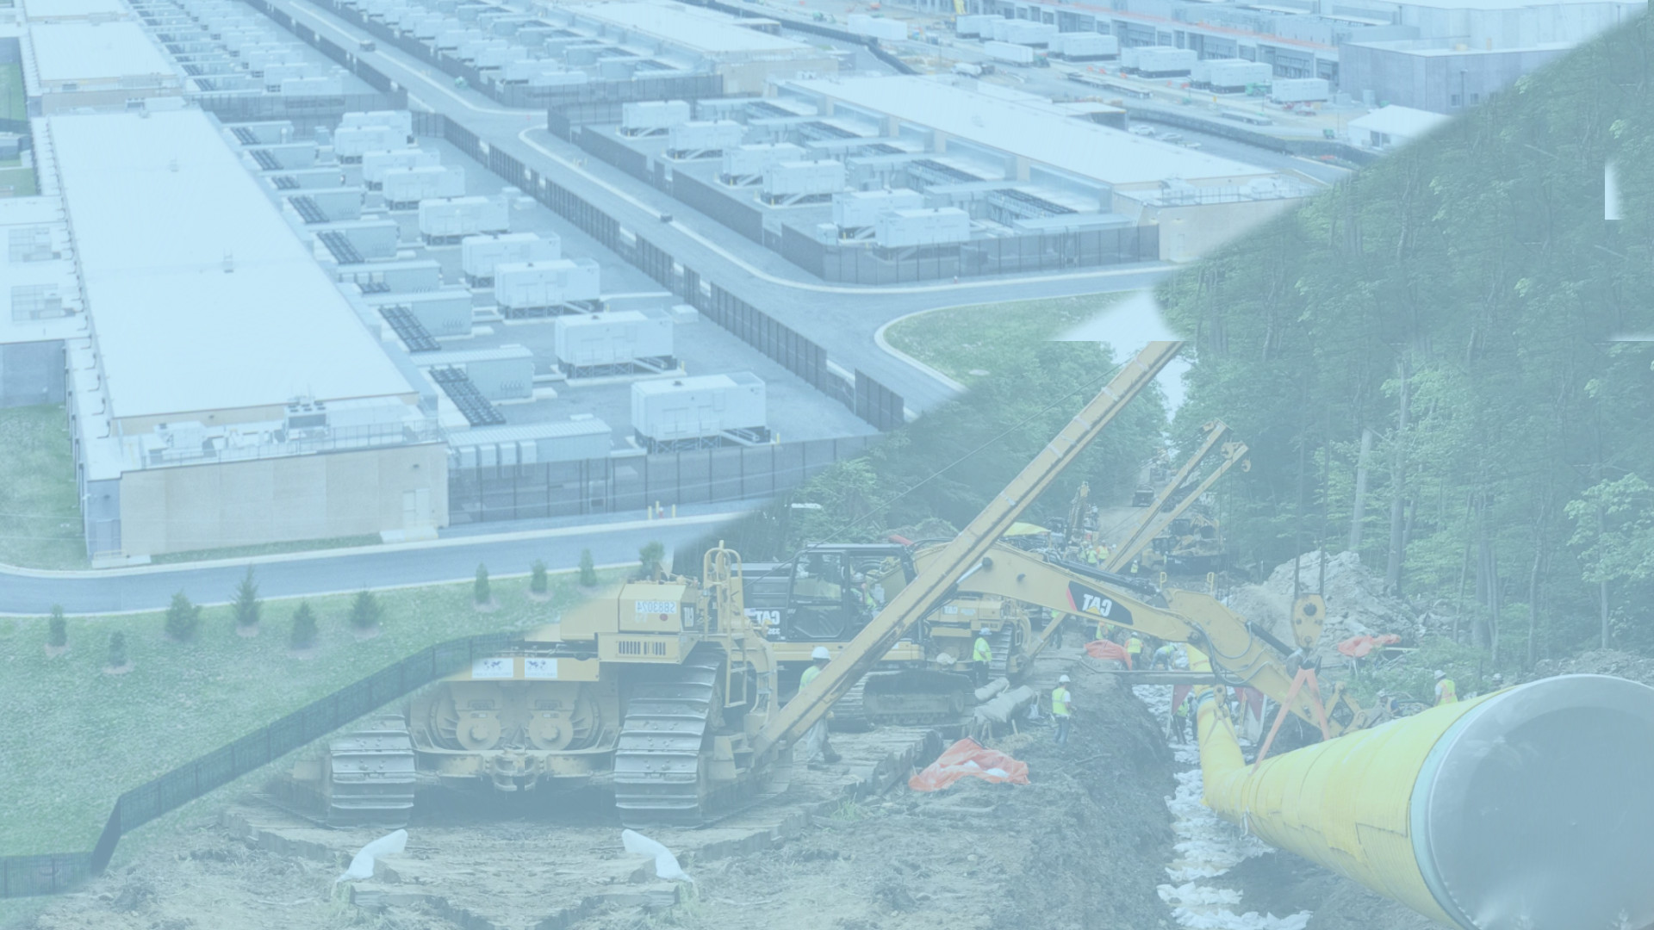


Data Center Power Demands Risk Increased Gas Pipeline Development
Rosemary Wessel
No Fracked Gas in Mass, a program of BEAT
rose@thebeatnews.org
Cathy Kristofferson
Pipe Line Awareness Network for the Northeast
kristofferson@plan-ne.org
June 2, 2026

Slide 2
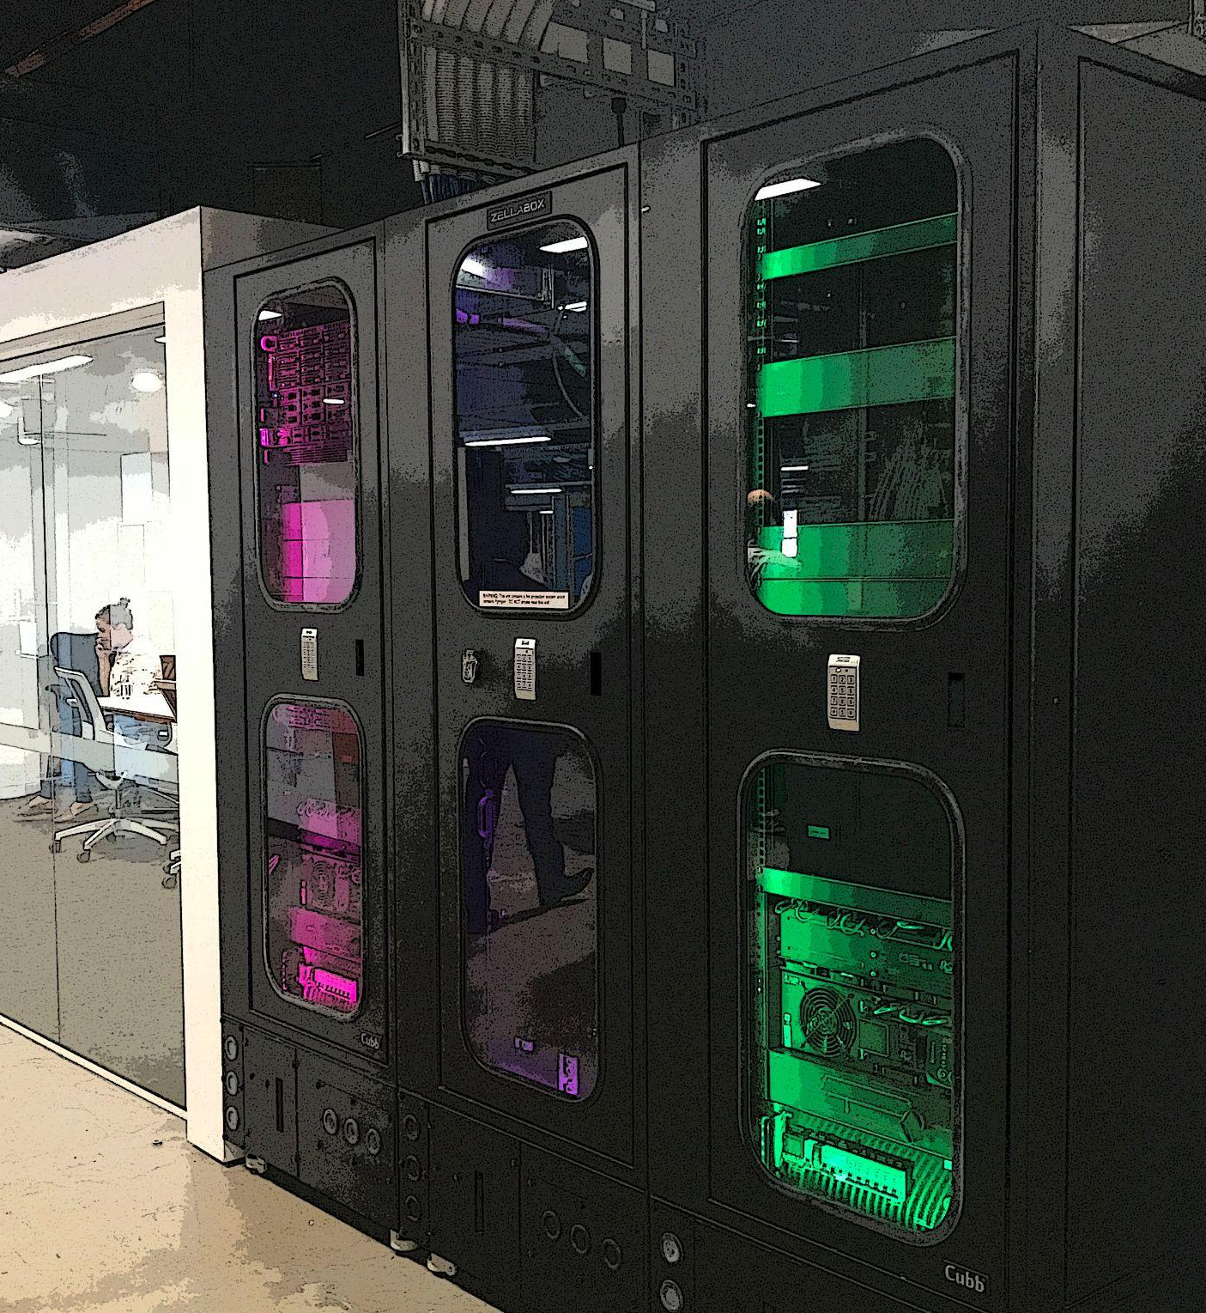
DATA CENTERS: Scale matters
Micro Data Center:
Usually 100 - 150 kW power
A few to 5K sq. ft.
Modular Data Centers:
Often mobile for temporary uses.
Usually 50 - 200 kW power
20 - 40 ft. shipping container
Edge:
Small, localized facilities close to end users.
Usually 1 - 10 MW power
10 - 10,000 sq. ft.

Slide 3
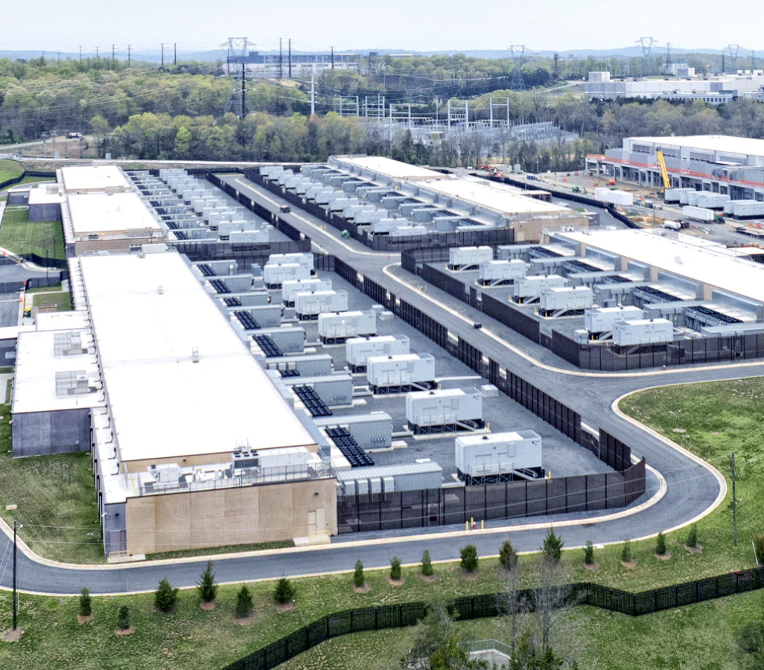
DATA CENTERS: Scale matters
Enterprise:
Facility-specific locations for a single entity
Usually 1 - 10 MW power
10K to 30K sq. ft
Colocation (aka “Carrier Hotel”):
Shared facilities for rent.
Usually 10 - 100 MW power
10K to 100K sq. ft.
Hyperscalers:
Designed for exponential and global scalability
and computational power.
At least 100 MW power, sometimes 1GW+
Usually 100K to 1 million+ sq. ft.

Slide 4
IMPACTS OF GRID-CONNECTED DATA CENTERS
- Massive load demand for larger classes of data centers, between 10 MW
to 1 GW or more. Not enough generation on the grid to support many larger projects.
ISO NE predicts 400 MW by 2040 (about 1.4% rise from current capacity).
Nationally, data center percentage of all power use from data centers has risen from 1.4% to 4.4%
- Volatile load demand - hundreds of MW or a GW+ can drop from peak demand to zero in a matter of seconds, depending on server function.
Voltage drops and spikes / grid transients
Reduced power supply quality damaging sensitive electronics nearby
Cascading power disruptions including blackouts
- Spike local utility rates - Need for upgrades to the grid
system are most often socialized to all utility customers.
Notes:
https://spectrum.ieee.org/data-center-power-fluctuation

Slide 5
NEW ENGLAND DATA CENTERS PROPOSALS GROWING
Most data centers currently in NE are mid-size, not hyperscalers. Nationally, this trend is shifting toward hyperscalers (over 100 MW load). Demand expected to triple by 2030.
Larger and hyperscale proposals are showing up in New England. Incentives could invite more.
Atlas Capital, Bloomfield, CT - proposal active
100-300 MW, 900K sq. ft., 127K sq. ft. substation
Smithfield, RI - proposal paused
100-300 MW, 250K sq. ft., town voted 4-1 to ban data centers
Westmass Development, Westfield, MA - proposal paused
150 - 300 MW, 2.7M sq. ft.
Nottingham, NH - proposal paused
Not specified, but of size that usually demands 100-300 MW
Sanford Woods Industrial and Technical Campus, Sanford, ME
- proposal paused, 300 MW,
Current largest
data centers:
40 MW Lowell
30 MW Boston
15 MW Somerville
13 MW Boston
Notes:
Merkley, Merkley, BOS4, BO1 https://www.mckinsey.com/industries/technology-media-and-telecommunications/our-insights/ai-power-expanding-data-center-capacity-to-meet-growing-demand
MA-https://westmassdevelopment.com/a-multibillion-dollar-data-center-project-is-coming-to-western-mass/
RI-https://smithfieldtownship.com/wp-content/uploads/2025/12/Smithfield-Gateway-Data-Center-Sketch-Plan-Review-No.-1.pdf
NH-https://newhampshirebulletin.com/2026/05/29/how-a-data-center-proposal-ignited-opposition-in-nottingham-and-surrounding-communities

Slide 6
BRING YOUR OWN POWER / GENERATION (BYOP / BYOG)
Volatile loads from data centers are driving a push for BYO proposals.
This is behind the meter (BTM) power generation, either near or directly at data centers
that encourages increase in gas supply and expansion of pipeline systems.
— Natural gas fired generators
Local pollution. In some cases, has led to un-permitted / un-regulated development by DC developers
Invites gas development like LNG storage, additional capacity on existing
nearby pipelines, new pipelines and laterals directly to data centers.
This is happening in other parts of the country and could happen here with the mix of development incentives and preference for BYO models.
• Around 75% of BTM power for data centers is gas-fired
• Govs. Lamont, Healey, Mills and Ayotte specifically
support Bring Your Own Power / Generation
Notes:
xAI centers in Memphis & Southhaven TN, https://www.theguardian.com/technology/2026/jan/15/elon-musk-xai-datacenter-memphis third, new GW development in Southaven under construction.
https://mississippitoday.org/2026/05/11/xai-46-gas-turbines-no-air-permits/
https://www.hoganlovells.com/en/publications/the-bring-your-own-generation-model-to-meeting-the-power-needs-of-data-centers-and-ai
https://hartfordbusiness.com/article/legislation-would-codify-bring-your-own-power-mandate-for-data-centers-large-power-users/
https://acadiacenter.org/new-state-law-could-power-cryptomining-data-centers-in-new-hampshire/
https://www.eenews.net/articles/data-centers-increasingly-turn-to-off-grid-gas/
https://cleanview.co/reports/behind-the-meter-data-centers

Slide 7

BYOP = Additional Gas infrastructure = Local emissions
Notes:
https://www.wired.com/story/new-gas-powered-data-centers-could-emit-more-greenhouse-gases-than-entire-nations/
https://www.linkedin.com/posts/steven-cocchi_data-center-developers-are-opting-for-behind-activity-7438199710370279425-fXWs

Slide 8
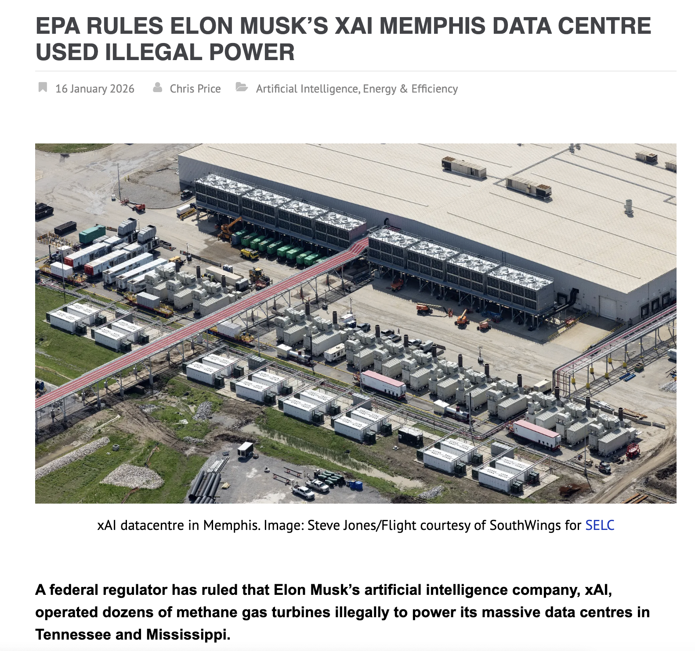
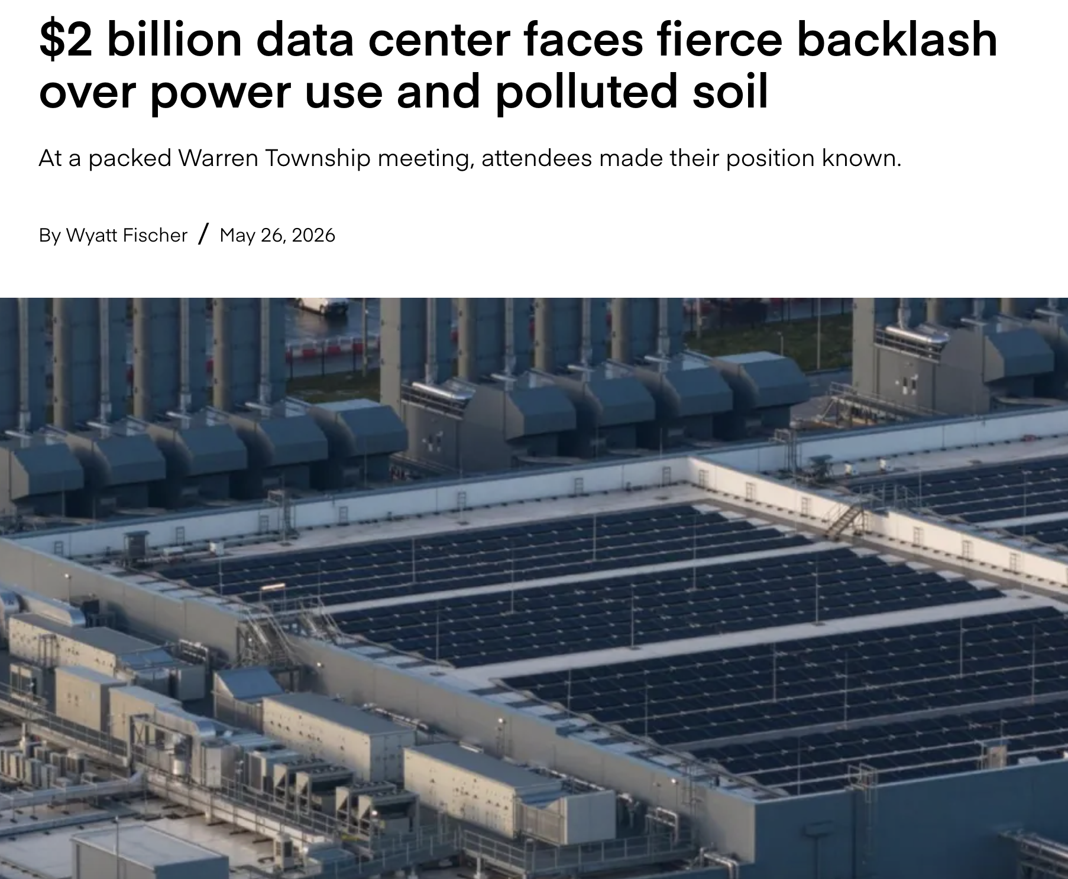
BYOP / BYOG = Local emissions
Notes:
https://www.thecooldown.com/green-business/data-center-investment-indianapolis-residents-fight-back/
https://www.techdigest.tv/2026/01/epa-rules-elon-musks-xai-memphis-data-centre-used-illegal-power.html

Slide 9
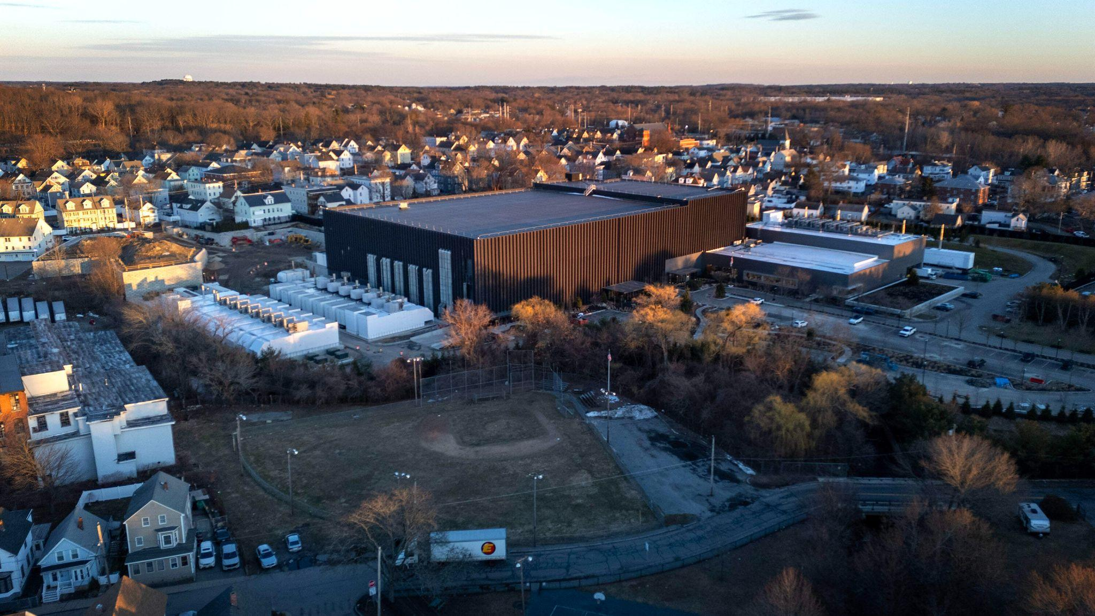
Notes:
https://commonwealthbeacon.org/energy/shifting-politics-around-data-centers-scramble-healey-ai-push/

Slide 10
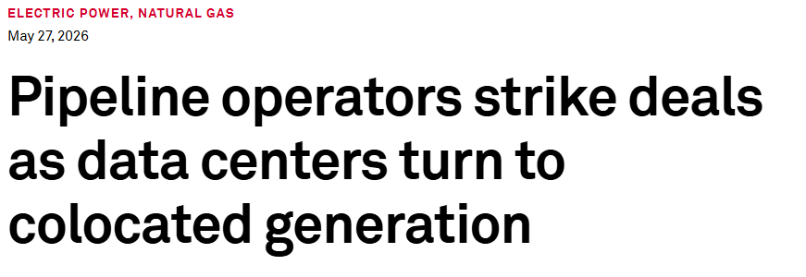
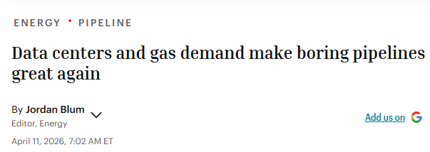
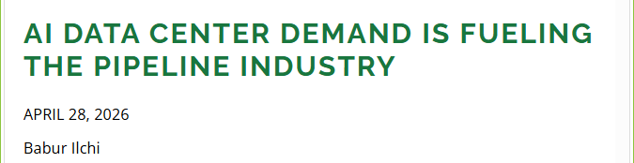
Pipelines as Enablers
“Natural gas pipelines are emerging as a critical enabler of decentralized power generation for AI infrastructure. By delivering fuel directly to onsite power facilities – whether entirely off-grid or behind-the-meter – pipelines allow data centers to bypass grid congestion and bring power online in months instead of years.”
Notes:
https://marketwise.com/investing/five-natural-gas-stocks-to-buy-as-ai-data-centers-devour-power/
https://www.spglobal.com/energy/en/news-research/latest-news/natural-gas/052726-pipeline-operators-strike-deals-as-data-centers-turn-to-colocated-generation
https://fortune.com/2026/04/11/data-centers-gas-demand-make-boring-pipelines-great-again/

Slide 11
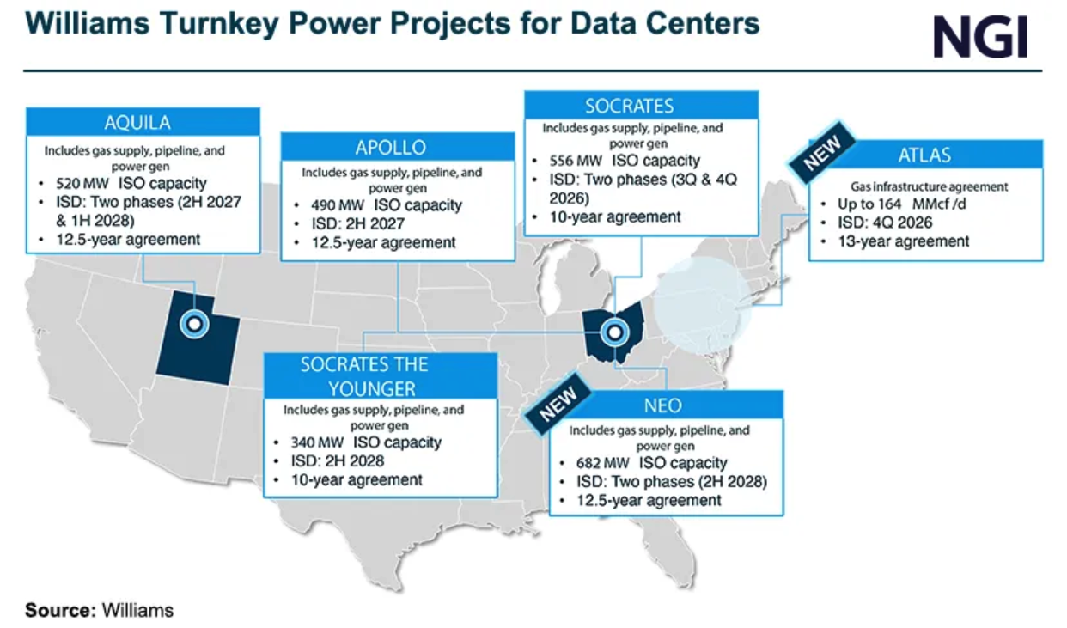
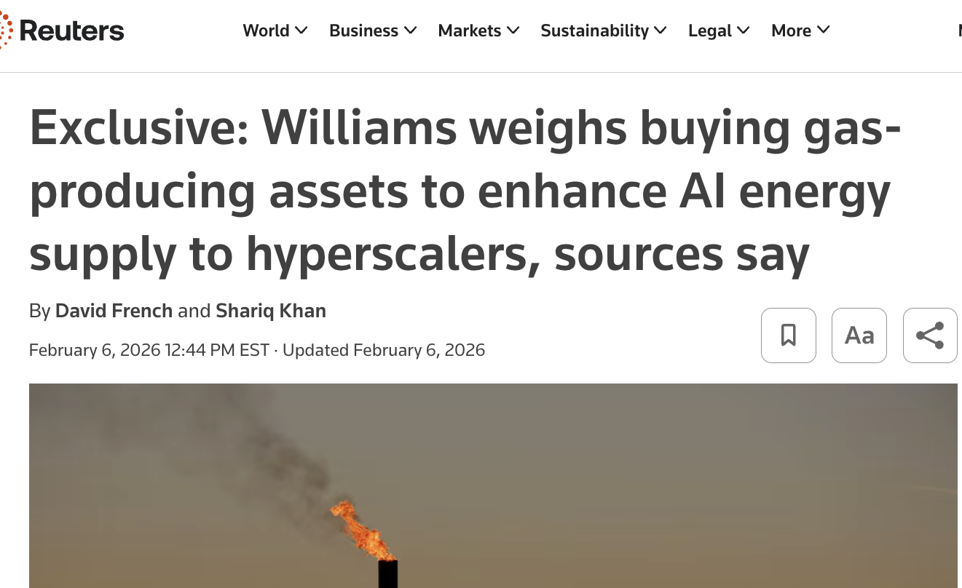
PIPELINE COMPANIES DELIVERING “ONE STOP SHOPPING”
Midstream pipeline company Williams is now developing BTM gas-fired generation and seeking gas production assets to offer “one stop shopping” for data center power supply.
This vertical integration offers full control of behind-the meter power supply to hyperscale data centers and includes additional mid-stream transmission and lateral pipelines.
Notes:
“These companies are leveraging their existing natural gas assets and capabilities to help meet rising demand for reliable power,” https://www.power-eng.com/gas/williams-pushes-deeper-into-power-generation-as-data-center-demand-accelerates/
Midstream gas transmission pipeline company Williams Co. is now developing BTM gas-fired power plants for data centers …
February 6, 2026 - Reuters
May 6, 2026 NGI - https://naturalgasintel.com/news/williams-sees-haynesville-marcellus-fueling-data-center-growth/

Slide 12
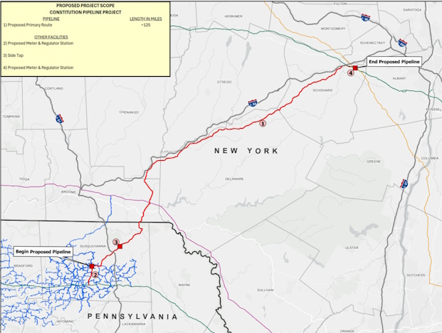
Wright Interconnect Project
TGP 200
Williams Co.
CONSTITUTION PIPELINE
Currently being reconsidered at FERC
Iroquois
Millennium
TGP 300

Slide 13
CURRENT PIPELINE EXPANSION PROPOSALS - Constitution
Williams Co., Constitution Pipeline - 124 miles of 30-inch-diameter pipeline with a
maximum allowable operating pressure (MAOP) of 1,480 pounds per square inch gauge (psig) new greenfield gas transmission supply line from fracking zone in NE Pennsylvania to gas hub in Wright, NY, just west of Albany. Would connect at both ends to Tennessee Gas 200 and 300 Lines, connect at end to Iroquois Pipeline.
New supply of 650,000 dekatherms a day coming from the fracking fields in PA to a gas hub just west of Albany, connecting to eastbound and southbound pipelines.
Currently no precedent agreements / no customers
Currently under consideration at FERC by special request for reissuance of the vacated certificate and previously contested permits.

Slide 14
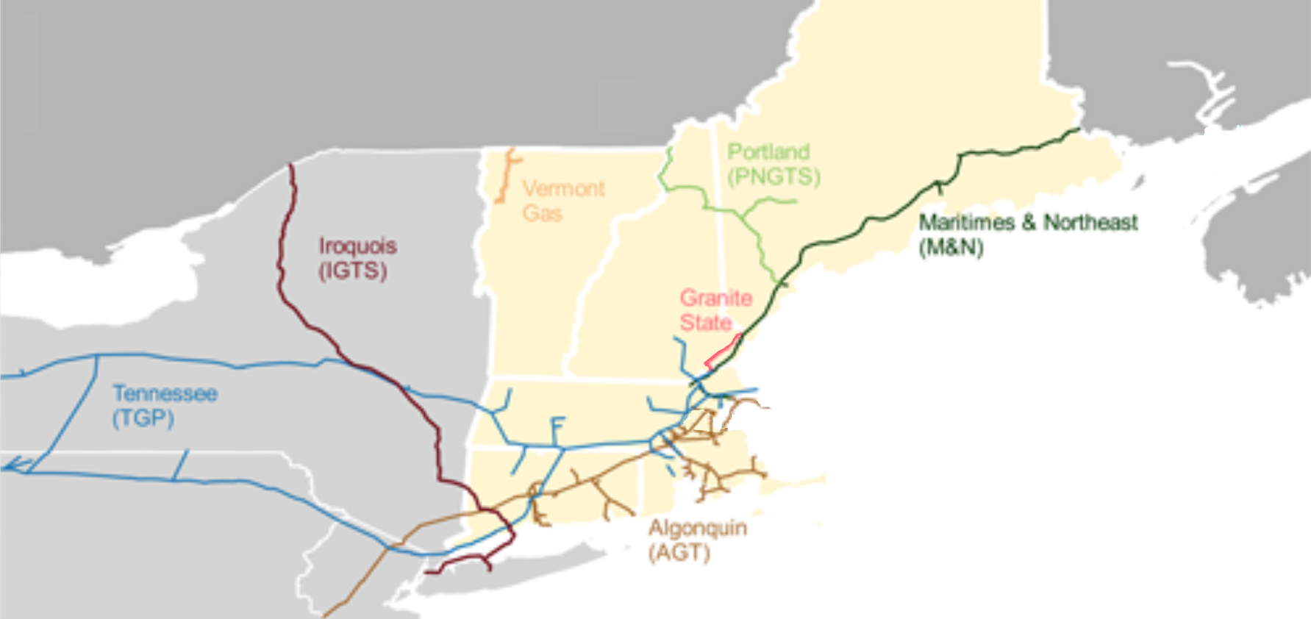
CURRENT PIPELINE SYSTEMS SERVING NEW ENGLAND
Algonquin (AGT) = Enbridge
Tennessee (TGP) = Kinder Morgan

Slide 15
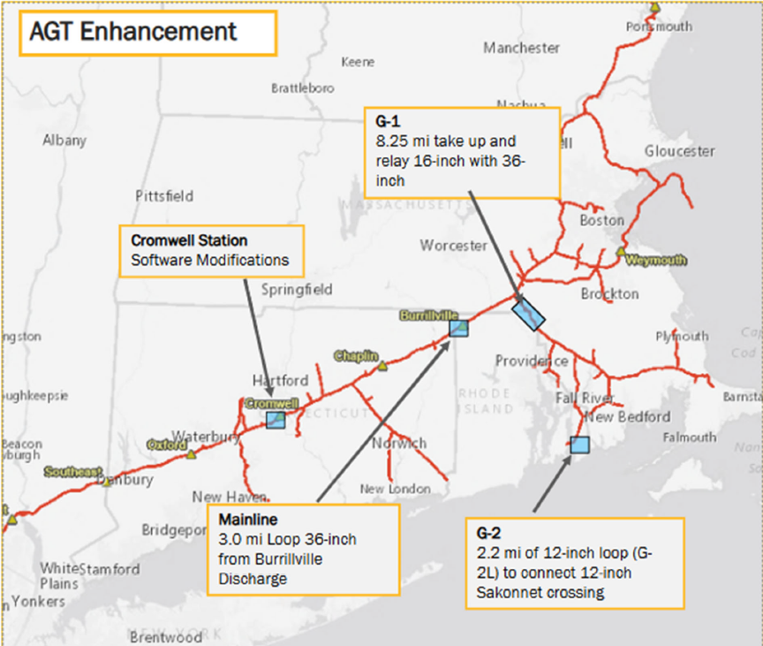
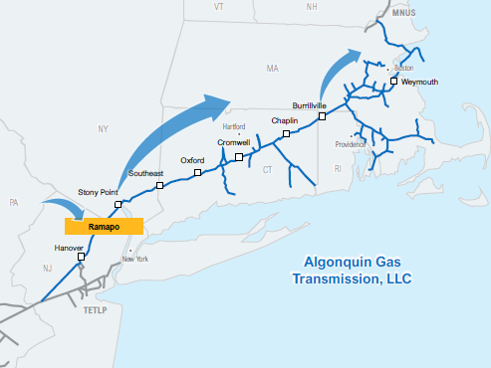
CURRENT PIPELINE EXPANSION PROPOSALS - ENBRIDGE (AGT)
“AGT Enhancement”/ R.A.R.E
Adding 73,500 dekatherms
Expansion sites in CT, RI & MA
Currently in pre-filing at FERC PF26-7
Fully subscribed; expected in-service 2028.
Estimated $300M cost
“Project Beacon”
Currently in Open Season til 7/1.
Offering to “LDCs, power generators, and other parties to manage their portfolio of needs”
Also offering “flexible in-region storage “
Could bring up to 300 million cubic feet per day
Tentative in-service 2030

Slide 16

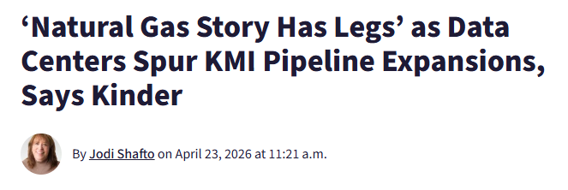
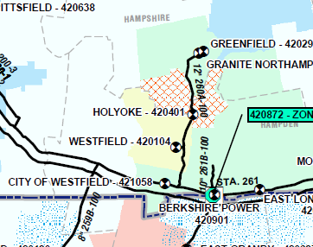
KINDER MORGAN (TGP)
• “Kinder Morgan is doubling down on
traditional pipeline infrastructure for LNG
exports and power generation, while Williams is pushing further down the value chain into power generation itself to capitalize on the data center power demand boom.”
• positioned to benefit from surging natural gas demand driven by AI data center and LNG export growth.
• anticipates long-term growth, citing projections of 13%–15% compound annual growth in electricity demand from data centers through 2030.
• projected gas use jumping by 30%± by 2030 because of data centers.
Notes:
https://naturalgasintel.com/news/natural-gas-demand-for-data-centers-its-no-hype-says-kinder-morgan-exec/#:~:text=The%20company%27s%20forecast%20is%20a,d%20specifically%20powering%20data%20centers
[fool] https://www.fool.com/investing/2025/01/27/this-500-billion-ai-data-center-investment-could-a/

Slide 17
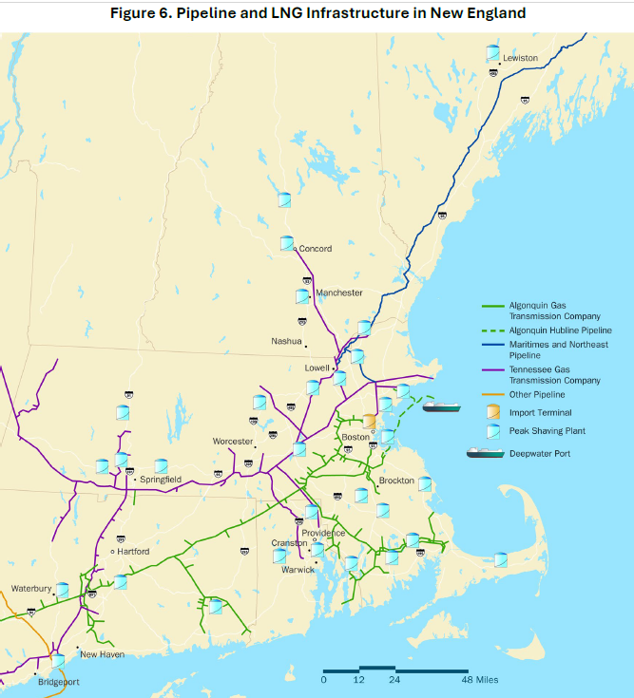
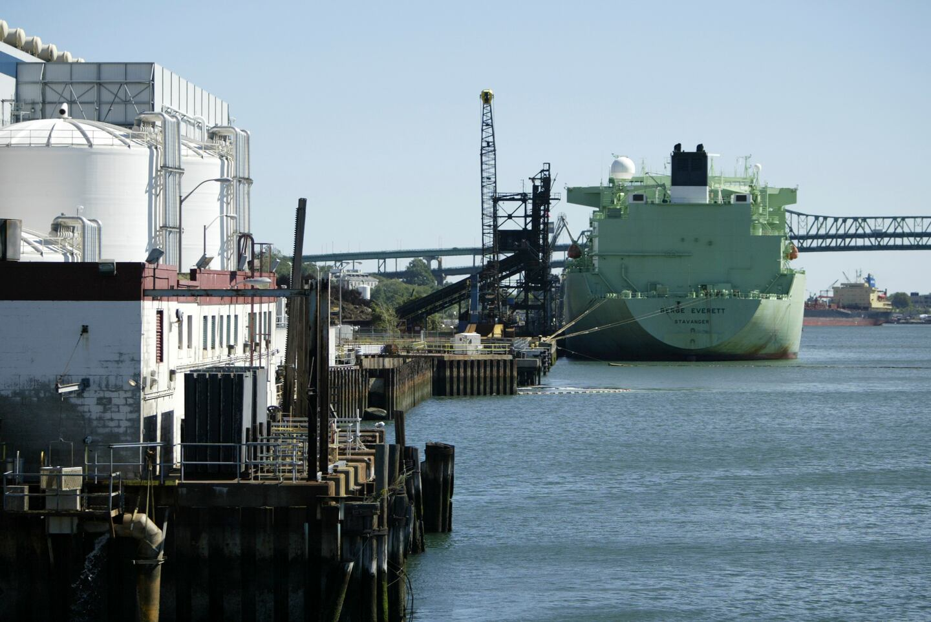
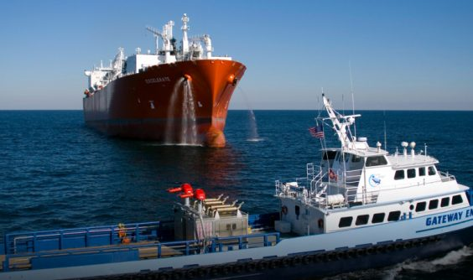
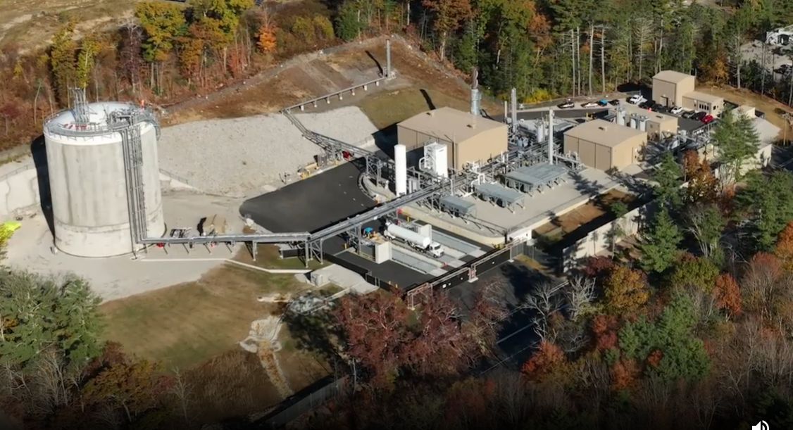
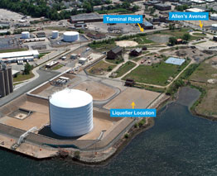
OTHER GAS EXPANSION?
Notes:
A 1 GW hyperscaler would need roughly 3 million gallons/day of LNG, about 300 truck deliveries
a 300 MW behind-the-meter project constructing a 1.5 million-gallon LNG storage tank that would provide 10 days of backup

Slide 18
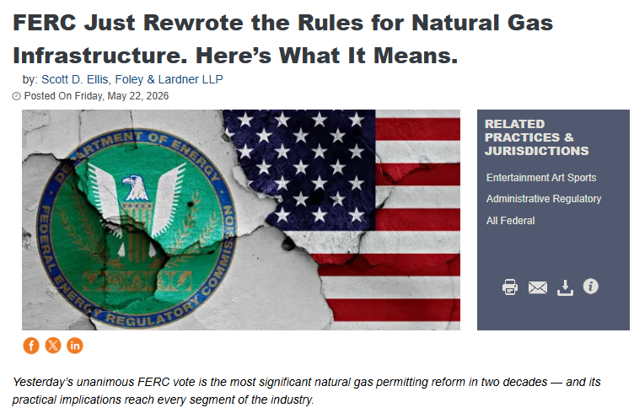
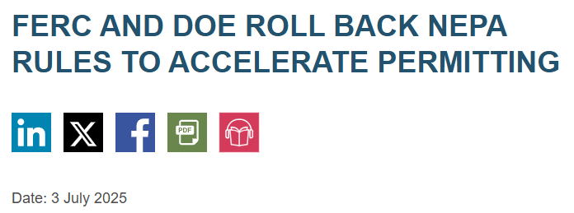
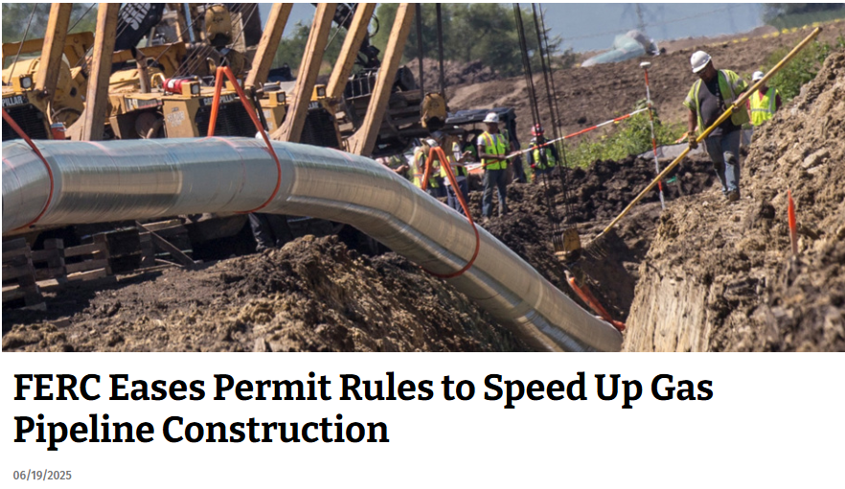
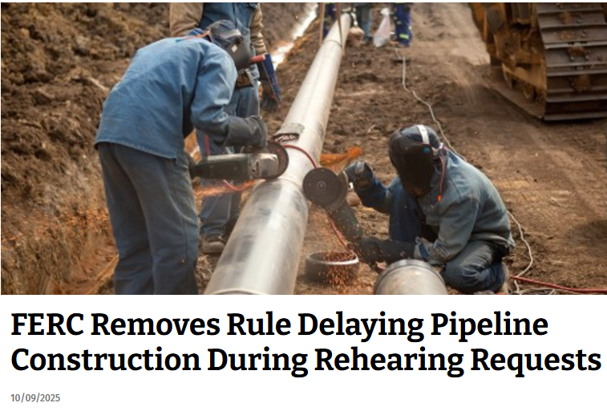
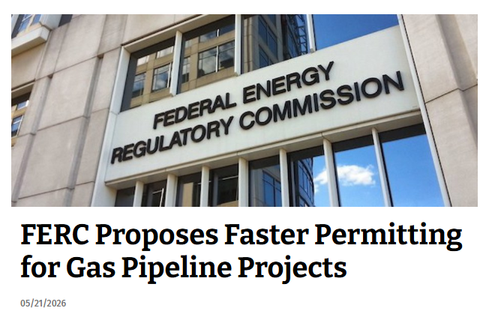
EXPEDITED PERMITTING
Notes:
RM25-9 to 6/2025 allow construction during/despite rehearing
RM25-12 Blanket Certificate Cost Limitations
5/21/26 order (NOPR) from 6/2025 inquiry:
-roughly double the cost thresholds that allow pipeline companies to build and modify infrastructure without seeking case-by-case FERC approval, or even abutter notifications
-expand the categories of projects eligible for streamlined authorization and extend the blanket certificate framework toward LNG facilities (new)
-allows capacity increases at existing compressor stations and M&Rs, within the existing fenceline
-adding into the rate base
Comments til July 27
https://pgjonline.com/news/2026/may/ferc-proposes-faster-permitting-for-gas-pipeline-projects
https://natlawreview.com/article/ferc-just-rewrote-rules-natural-gas-infrastructure-heres-what-it-means

Slide 19
STRANDED AND ABANDONED ASSETS
If the data centers close or fail, all that new gas infrastructure and capacity could be at risk of being left behind or for new uses to be found endangering transition.
“...utilities face the risk of stranded investments if infrastructure is built to serve loads that ultimately choose to self-supply. … Developers will continue to build around constraints, creating parallel systems of supply that operate alongside, rather than within, traditional market structures. Over time, that could make coordination more difficult, not less.” ~RTOInsider 5/21/26
“power plants and data centers may outlast the viable pricing of the gas dictated by the intended use. “
“...new natural-gas plants, which are scheduled to be up and running starting in
2028 and will have a typical lifetime of around 30 years”

